Slide 1
Twitter Bot Detection
Eldin Šahbaz, Raymond Hu, Omer Winrauke, Josiah MacDonald
Notes:
Data Mining: Josiah MacDonald

Slide 2
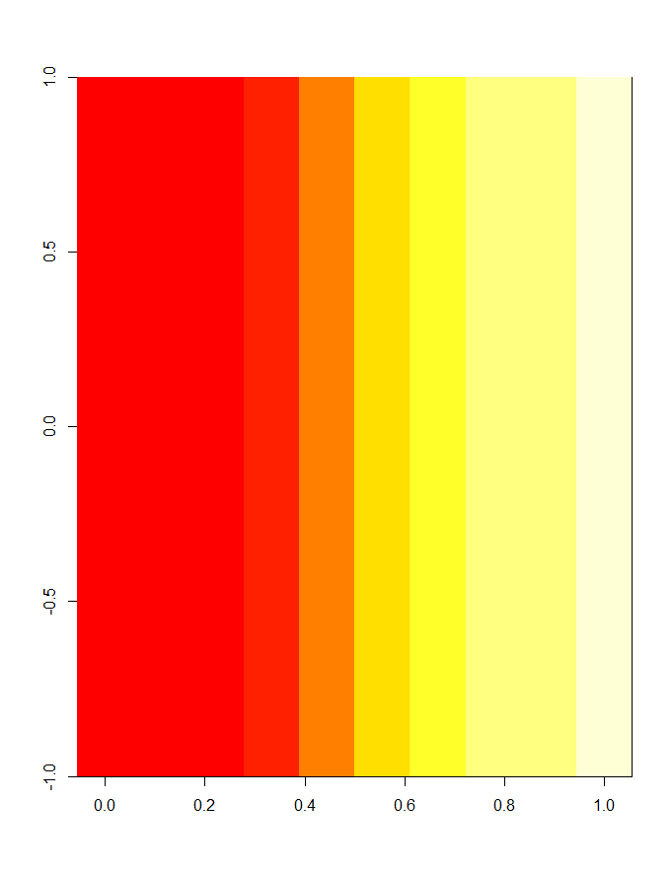
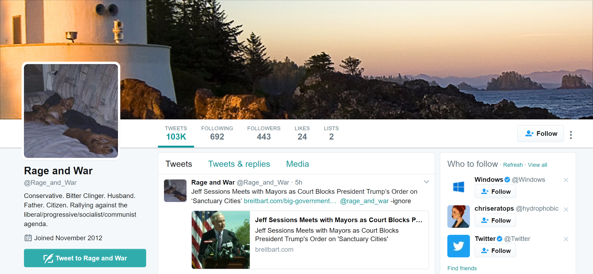
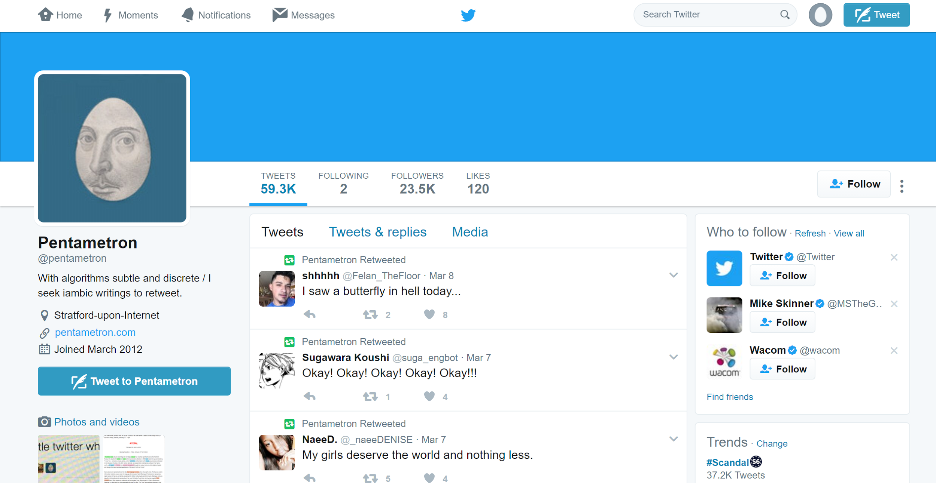
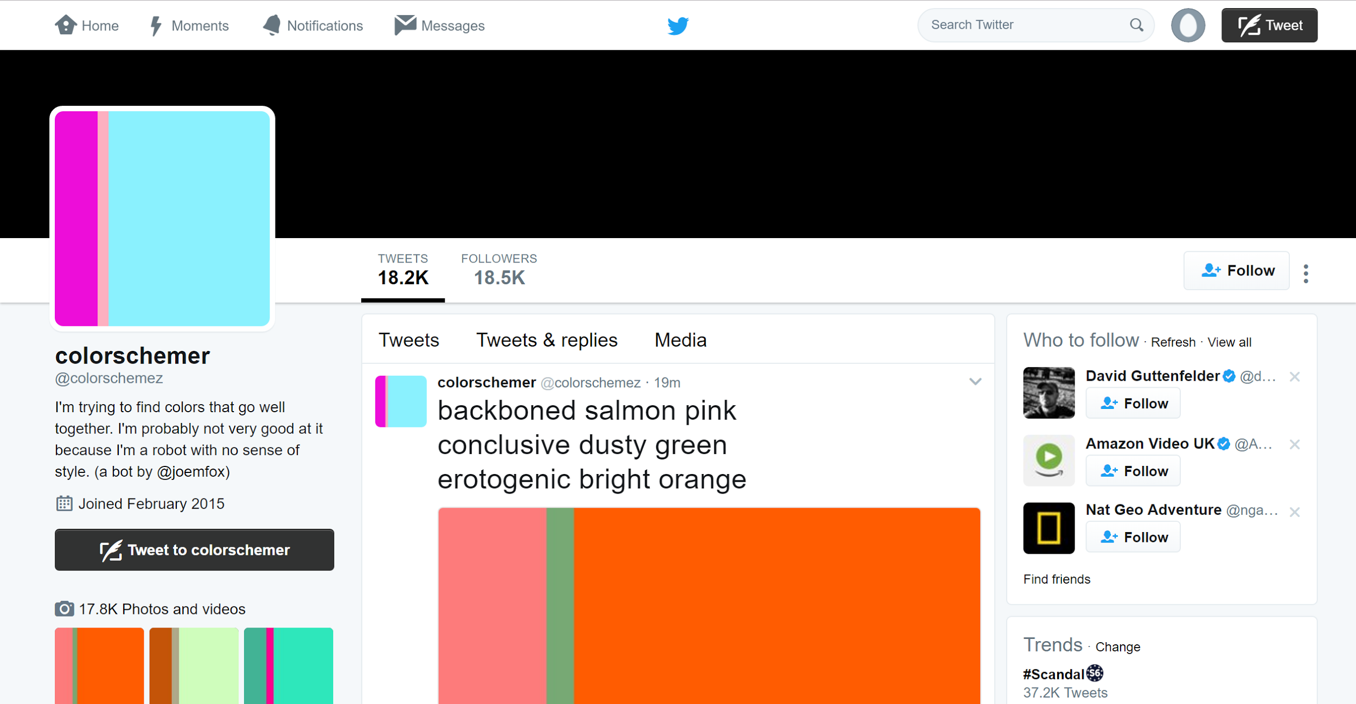
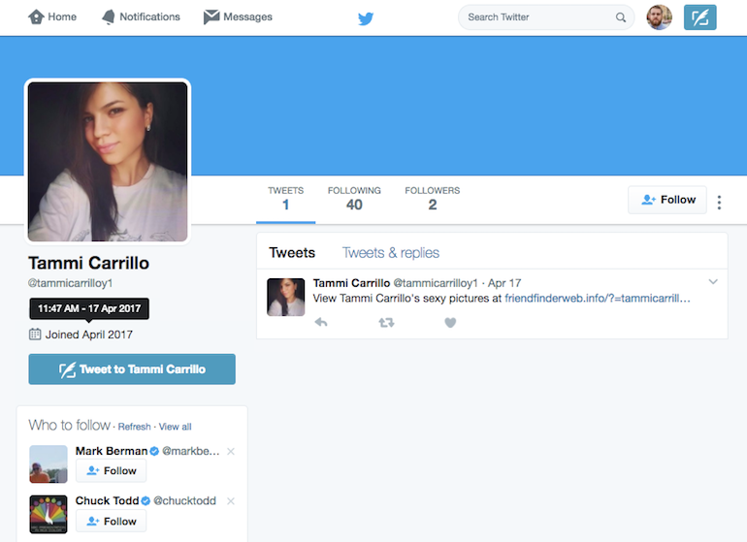
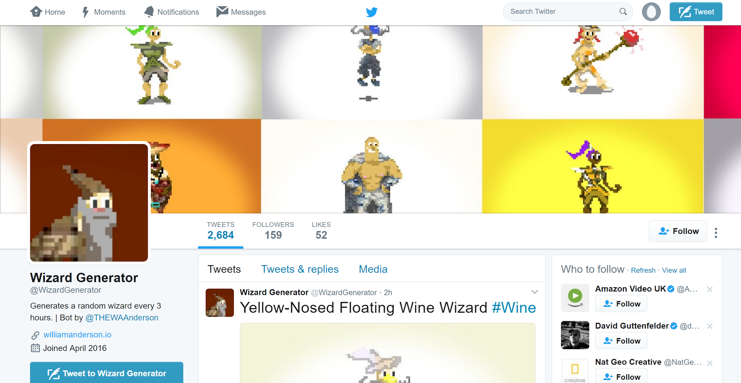
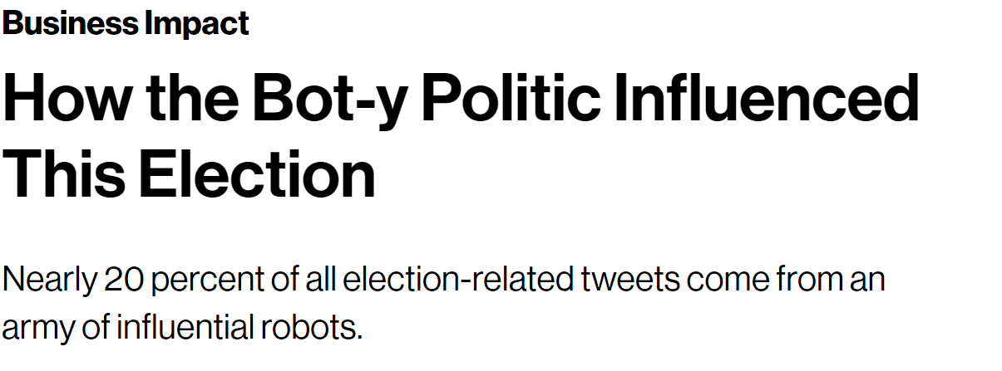
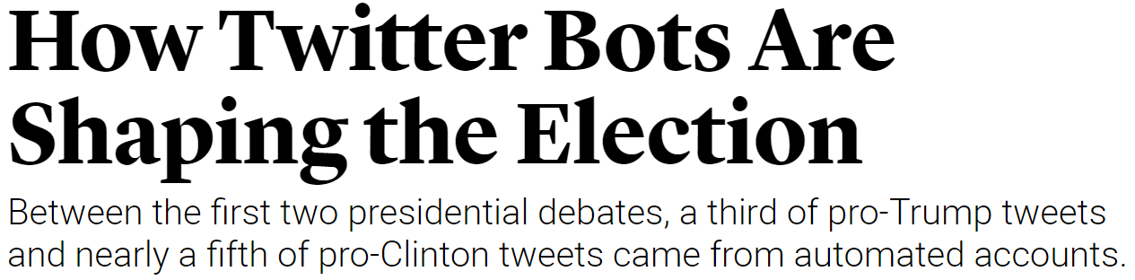
Twitter Bot Detector
High Medium Low
Notes:
Data mining: Josiah MacDonald
These bots are seemingly more difficult to classify than spam bots. Published content is more sophisticated. More realistic follower:friend ratio. Typically have longer life spans.
Bots in the high end of the spectrum disguise themselves as humans and generally do so to promote or diminish someone/something. It was estimated that 80% of Trump’s Twitter traffic was a result of bots.

Slide 3
Data Collection
Manually aggregated user profiles from our networks
Easy to verify real users
Manually aggregated bots from various Twitter lists/bot wiki.
Bot Wiki
Bot List
Harvested profiles and timelines via Twitter API
Notes:
Data mining: Josiah MacDonald

Slide 4
Possible Features?
favourites_count
name
notifications
url
created_at
contributors_enabled
time_zone
protected
default_profile
is_translator
follow_request_sent
has_extended_profile
profile_use_background_image
default_profile_image
id
profile_background_image_url_https
verified
translator_type
profile_text_color
profile_image_url_https
profile_sidebar_fill_color
entities
followers_count
profile_sidebar_border_color
id_str
profile_background_color
listed_count
status
is_translation_enabled
utc_offset
statuses_count
description
friends_count
location
profile_link_color
profile_image_url
following
geo_enabled
profile_background_image_url
screen_name
lang
profile_background_tile
Notes:
Data mining: Omer Winrauke
There were over 40 possible features

Slide 5
Data Processing
What didn’t work?
screen names
Hashtags
URLs
Locations
Sources
Tweet classification via TF-IDF and SVM
Individual tweets are too small of a sample,
SVM 0% accuracy
Notes:
Data mining: Omer Winrauke
Before we go into the features that we did choose, let’s discuss some of the ones we didn’t choose
Filtered text. Removed stop words, symbols, emojis and encoded in utf8. Computer lexical diversity. If an account either had 0 tweets or all the tweets were filtered out, we replaced the lexical diversity with the average diversity of the users/bots (depending on which class we’re filtering at the moment). We did this to avoid any outliers in the data. The only time when we do use 0 for lexical diversity is when none of the accounts in the set tweeted or all of their tweets were filtered.
URLs are too unique
Same issue with sources/hashtags. How to measure so that it makes sense? Empirically bots had some weird sources since people wrote programs. In terms of quantity, both bots and humans seemed to have about the same amount. For hashtags, if we want to generalize to the hard problem, then bots will often times use same hashtags as humans (i.e. not a good measure)
Location was difficult to use -> often times misspelled/not a real location. Tried to use autocorrect to get real location of misspelled, but didn’t work too well.

Slide 6
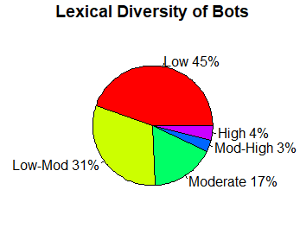
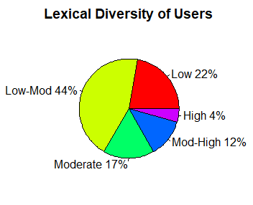
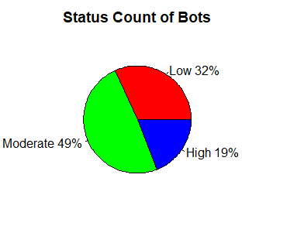
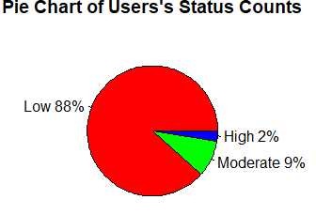
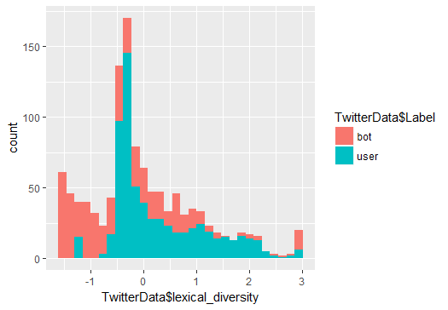
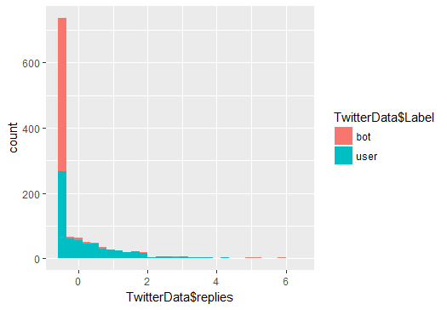
Notes:
Data mining: Ray Hu
In total we used 7 features: Lexical Diversity, friend to follower ratio, status count, reply count, quote count, tweet frequency, and listed count. Of these, lexical diversity and status count seemed the most interesting

Slide 7
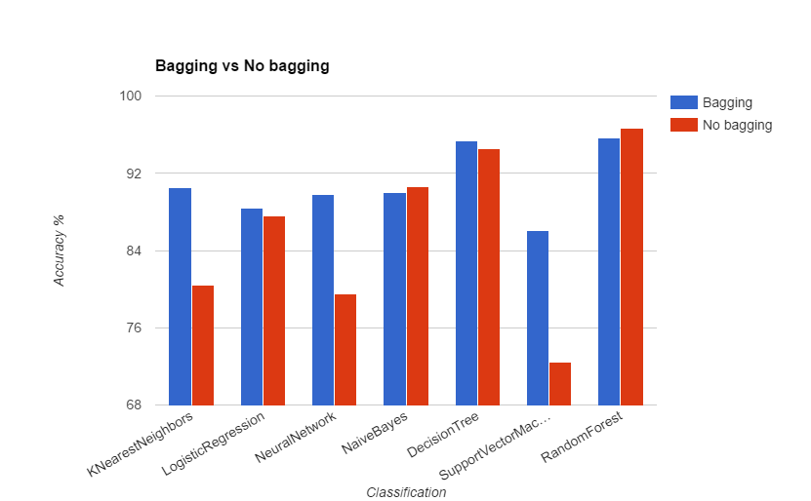
Classification
Random Forest
Decision Tree
K Nearest Neighbor
Naïve Bayes
Multi Layer Perceptron
Logistic Regression
Support Vector Machine
Notes:
Data mining: Ray Hu / Eldin
We first began assessing the accuracy of our classifiers via the hold out method but then switched to K-Fold Cross Validation since it’s more reliable. We used a K of 10 for our assessments.
Prior to using bagging to boost classifier performance, the results from ranged from high 50s to low 70s. Typically SVM got in the 50s while KNN got in the 70s. With Bagging, the classification rates were boosted to range from low 80s to high 90s.
The accuracy rates observed from the Random Forest classifier are the highest. We were expecting this since research papers reported similar results. The decision tree with bagging is similar to the Random Forest classifier, however Random Forest classifier segment features into disjoint sets while Decision Trees that use Bagging do not.
The Decision Tree with Bagging and Random Forest are typically within a few percents of each other while the other classifiers are classifers are within a few percents of each other. The difference between the two groups is 10% on average.
For graph, averaged the accuracy rates of 100 iterations for bagging and 100 iterations for non bagging
Naive bayes only does marginally better without bagging than with bagging. The difference is within 1%

Slide 8
Findings
Similar approach to spam bots, but more sophisticated training data is imperative.
Random Forest always has the highest 10 fold cross validation rating
Bagging generally improved performance
With the exceptions of Naïve Bayes and Random Forest
Notes:
Data mining: Ray Hu
Generally, techniques that work for detecting spam bots also work for this data set

Slide 9
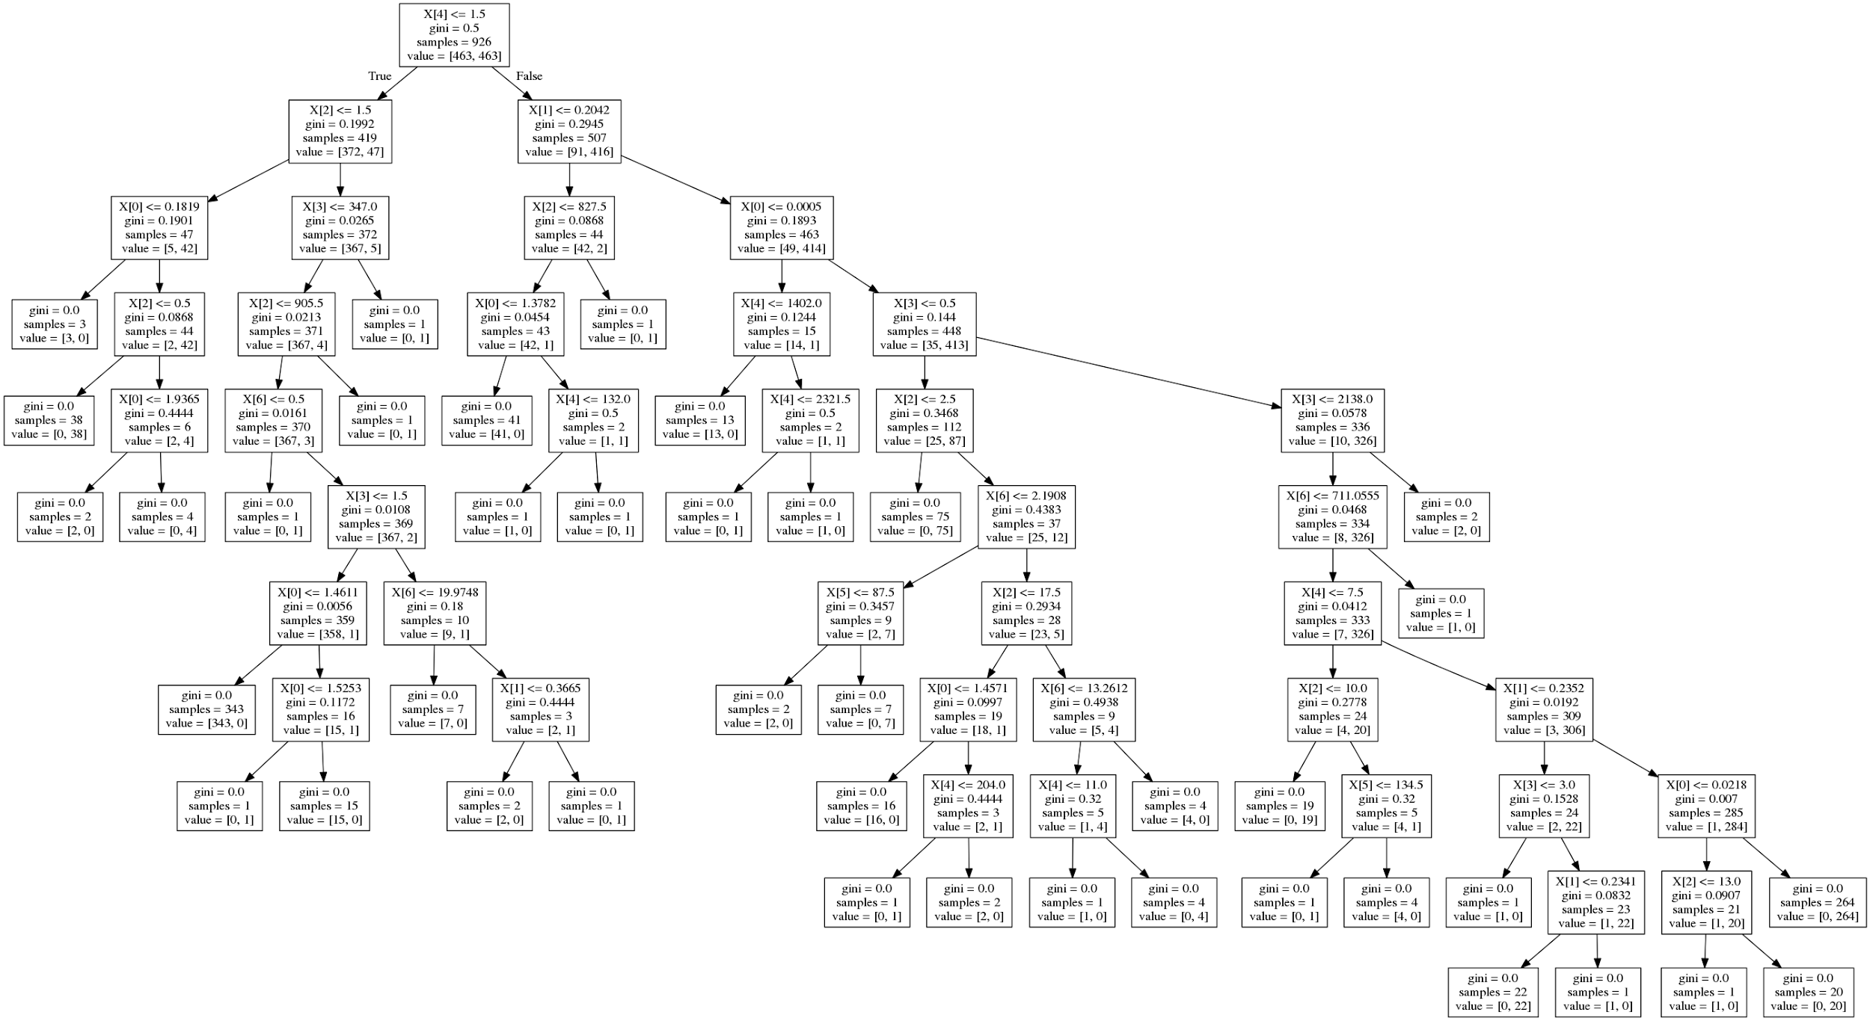
X[0] | Follower ratio
X[1] | Lexical diversity
X[2] | Listed count
X[3] | Quotes
X[4] | Replies
X[5] | Statuses count
X[6] | Tweet frequency
Notes:
Data mining: Ray Hu

Slide 10
Future Work
Incorporating text data
Finding more and better quality data
More representative of the general public
Test our methods on multiple data sets
Tweet randomness
Include media
Crawl Network
Spend more time analyzing features and effects on results
Use PCA/information gain to help select features
Deep Learning
Notes:
Data mining: Eldin Sahbaz
NLP
Bot sources/hashtags vs User sources/hashtags
Convert set of Nominal values into a vector of binary attributes, then compute distance by converting binary string into decimal value (idea from rank order clustering)
Grouping Tweets into a document by a time interval since each individual tweet is too small of a sample
Sentiment analysis because bots in the higher end of the spectrum generally operate with the goal is to influence people Their rehtoric will most likely either be negative or positive.
Results are bad if data is bad
The idea is if you think of randomness of tweets times as a scale of very random or not random at all, then, we believe, that bots will either be very random or not random at all. This makes sense because bots are programmed to tweet. Meaning they either have a set time interval for when to tweet or they randomly send tweets out.
Can use a CNN and RNN to caption an image which will convert a computer vision problem into a text mining problem. We can use subsampling to approximate an image but that doesn’t do as good a job as filtering stopwords, stemming, and lemmitization does in terms of feature space reduction
Tight network of bots is true for spam bots, but how about these more sophisticated bots? We need to study the network structure to generalize this to more sophisticated bots.
Include Media:
Convert computer vision problem into text mining
Crawl Network
Node Centrality
A research paper use information gain to assign weights to possible features in order to see which ones to select and which ones to leave out
Node Centrality
Eigen/Pagerank
Betweenness
Closeness

